Slide 1
Learning in the Neocortex
Randall C. O’Reilly
University of California Davis
eCortex, Inc

Slide 2
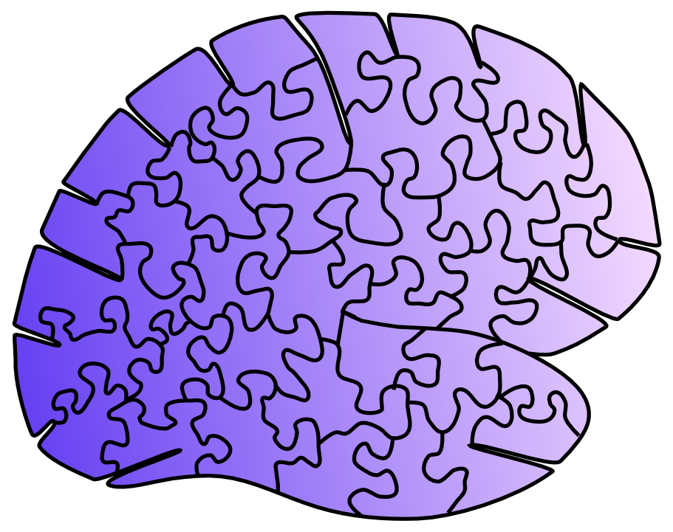
Learning is an embarrassment… (of potential riches!)
It is embarrassing how little we know about learning in the one place that really matters: the neocortex.
We know more about most other brain areas:
Basal Ganglia, Cerebellum, Hippocampus..

Slide 3
“What works”
Neuroscience
How do we get to “and”?

Slide 4
What Works:
Not biological: error backpropagation
Not psychological (where is that hand when you need it!?)

Slide 5
What Works:
Not biological: error backpropagation
Not psychological (where is that hand when you need it!?)

Slide 6
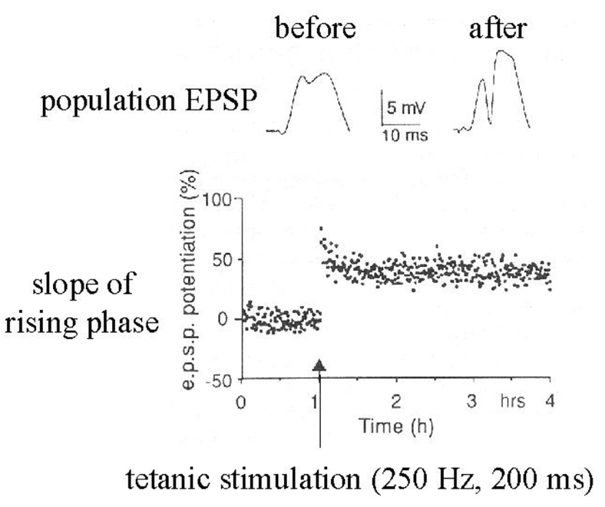
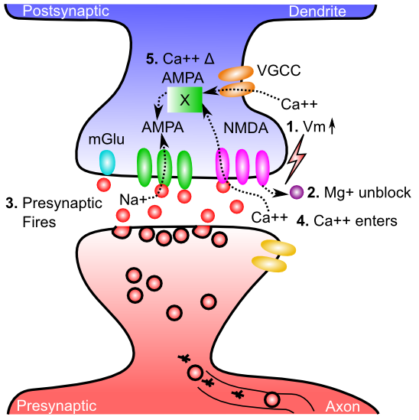
Neuroscience: Hebbian
Just one little problem: It doesn’t work!

Slide 7
“What works”
Neuroscience
How do we get to “and”?

Slide 8
Three Levels
Computational level: error-driven & predictive learning
Implementational level: thalamocortical loops
Functional level: does it actually work?

Slide 9
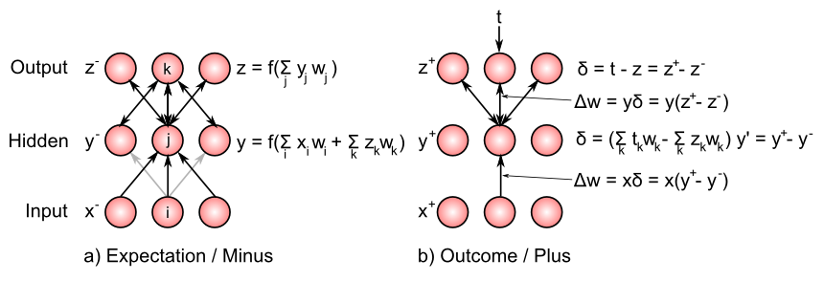
Bidirectional Connections Carry Error Gradients (GeneRec; O’Reilly, 1996)
dW = x⁺y⁺ - x⁻y⁻
(Midpoint integration + symmetry = Contrastive Hebbian = DBM)

Slide 10
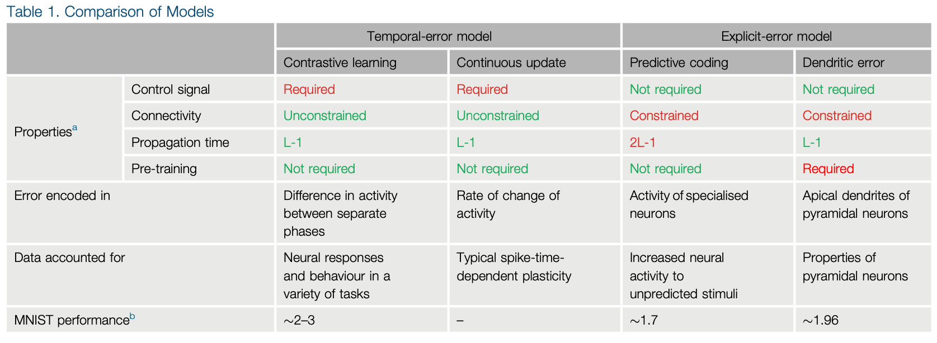
Many different approaches.. (Whittington & Bogacz Review, TICS, 2019)
Scellier, B. and Bengio, Y. (2017) Equivalence of equilibrium propagation and recurrent backpropagation. arXiv preprint arXiv:1711.08416
Lillicrap, T. P., Santoro, A., Marris, L., Akerman, C. J., & Hinton, G. (2020). Backpropagation and the brain. Nature Reviews Neuroscience, 21(6), 335–346.

Slide 11
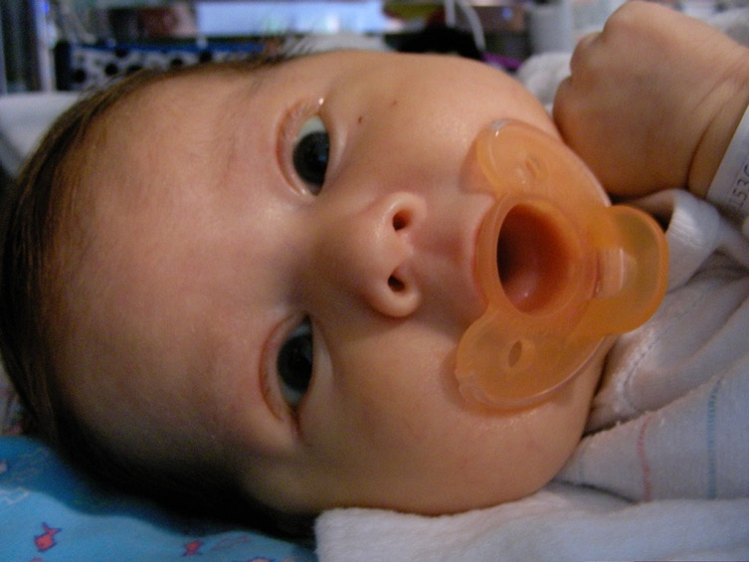
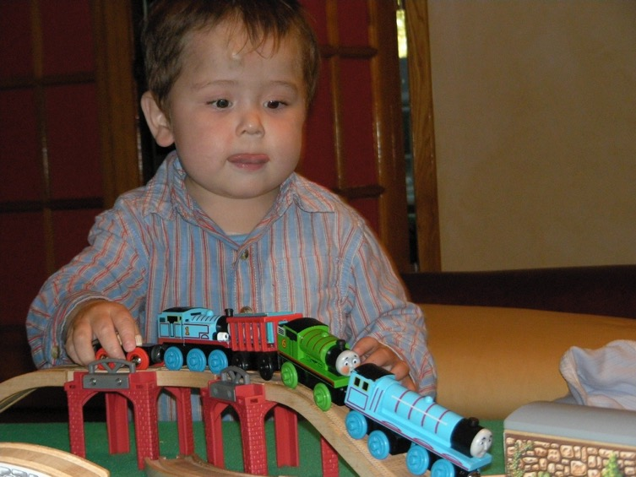
The Mystery of (Knowledge) Development
The first ~6 months: passive, but intent, staring at the world moving by..
And yet, so much is learned: the foundation for everything we know..
How does this happen!?

Slide 12
Helmholtz: Recognition by Synthesis
Auto-encoders, Bayesian models, Rao & Ballard, Friston et al..

Slide 13
Key idea: We learn by constantly generating hypotheses or predictions about what will happen next!

Slide 14
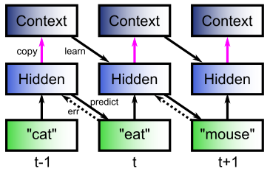
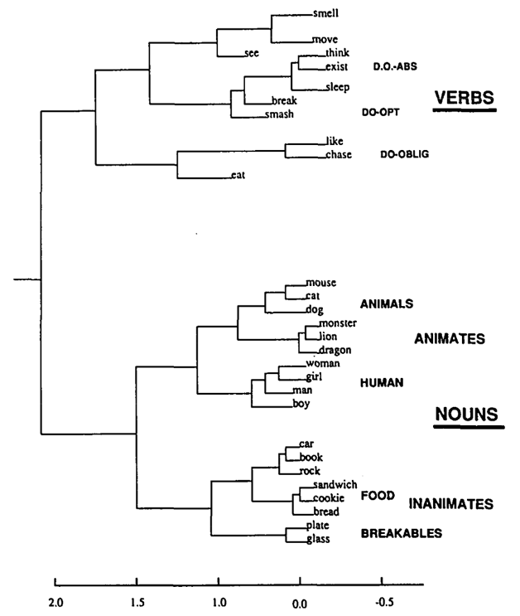
The Predictive Bootstrap (Elman 1990; Elman, Bates, et al. 1996)
Learning to predict words induces verb vs noun category representations in hidden layer of SRN
The future is free!
If you can predict it, you know it!

Slide 15
Biologically, how does it work?

Slide 16
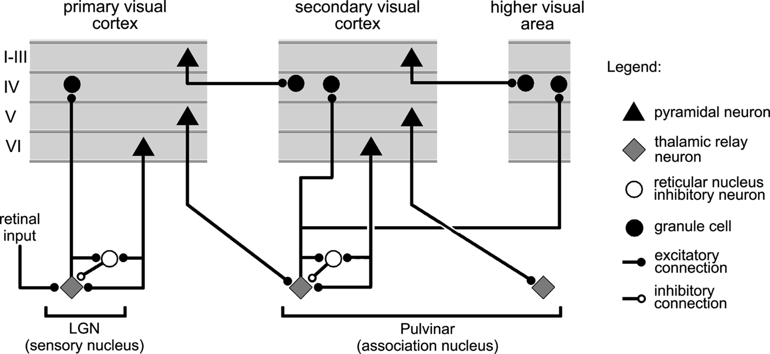
Thalamocortical Loop Biology (Sherman & Guillery, 2006)
5IB
FF
Driver
Weak
FB
“What happens”
Prediction

Slide 17
The Pulvinar = Projection Screen (c.f. Mumford, 1991 “blackboard”)
Pulvinar receives connections from all over visual cortex
and projects back out to these same areas
Two inputs:
1. Few strong feedforward:
“what happens”
2. Many weaker feedback:
prediction
Pulvinar!

Slide 18
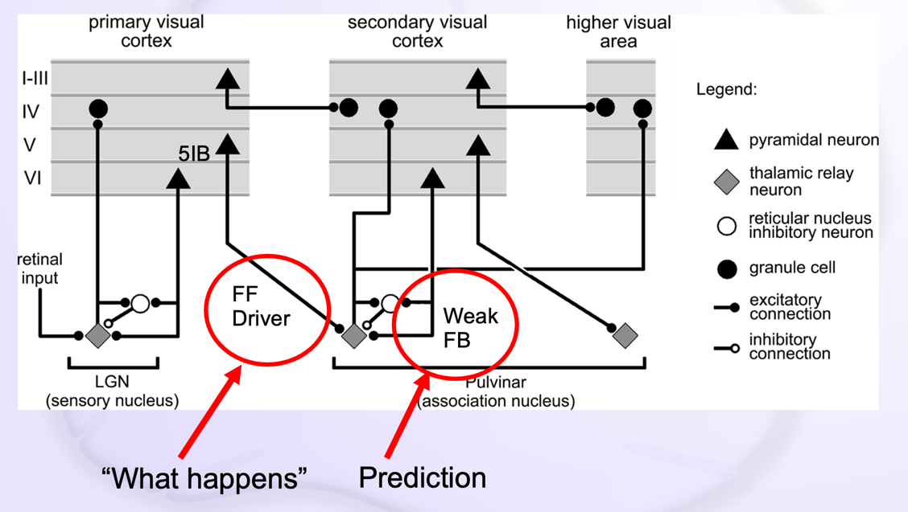
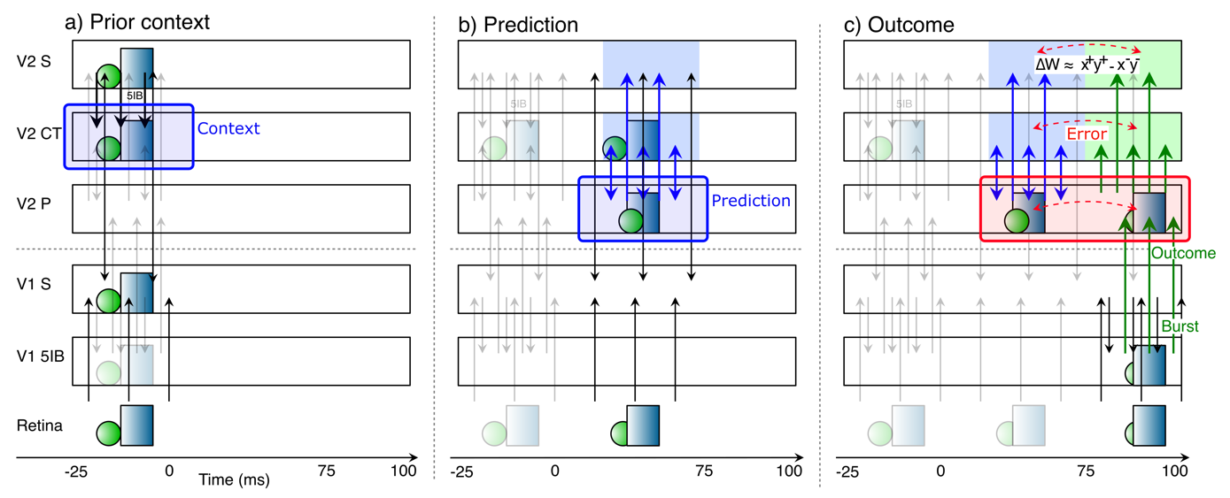
Deep Predictive Learning

Slide 19
Synapse-Level Learning
Requires learning to be driven by a temporal difference error signal.

Slide 20
Gettin’ AMPA’d

Slide 21
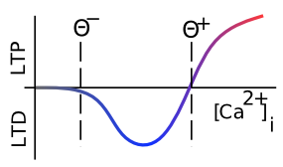
Which Way?

Slide 22
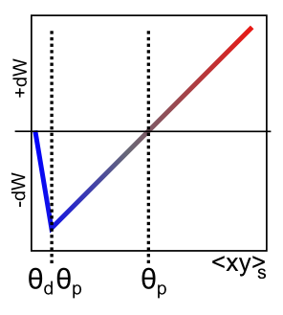
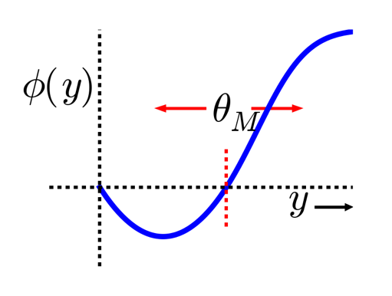
XCAL = Linearized BCM
Bienenstock, Cooper & Munro (1982) – BCM:
adaptive threshold Θ
Lower when less active
Higher when more..
(homeostatic)

Slide 23
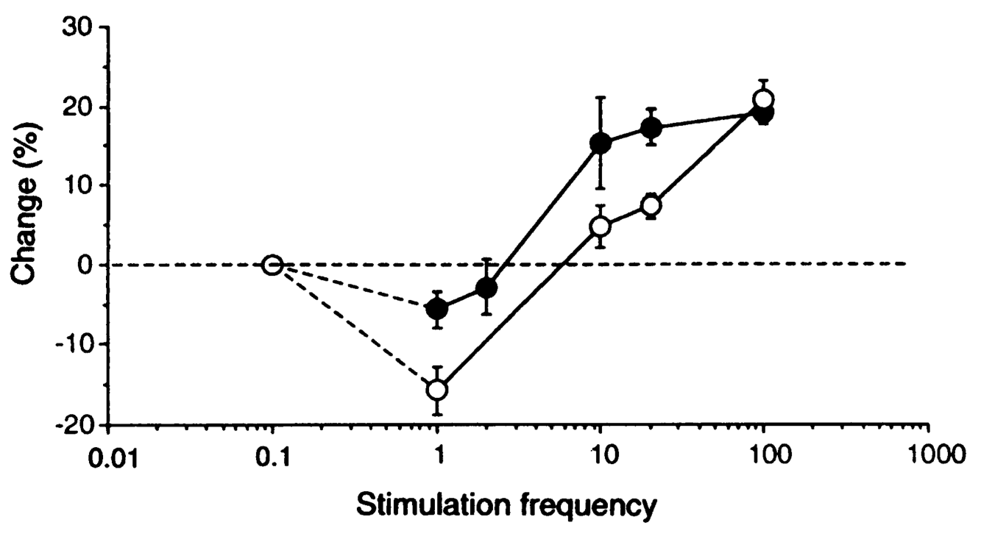
Threshold Does Adapt

Slide 24
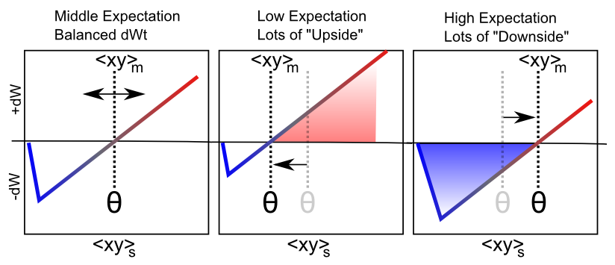
Floating Threshold = Medium Term Synaptic Activity (Error-Driven)
dW = Outcome – Expectation = <xy>_{s} - <xy>_{m}

Slide 25
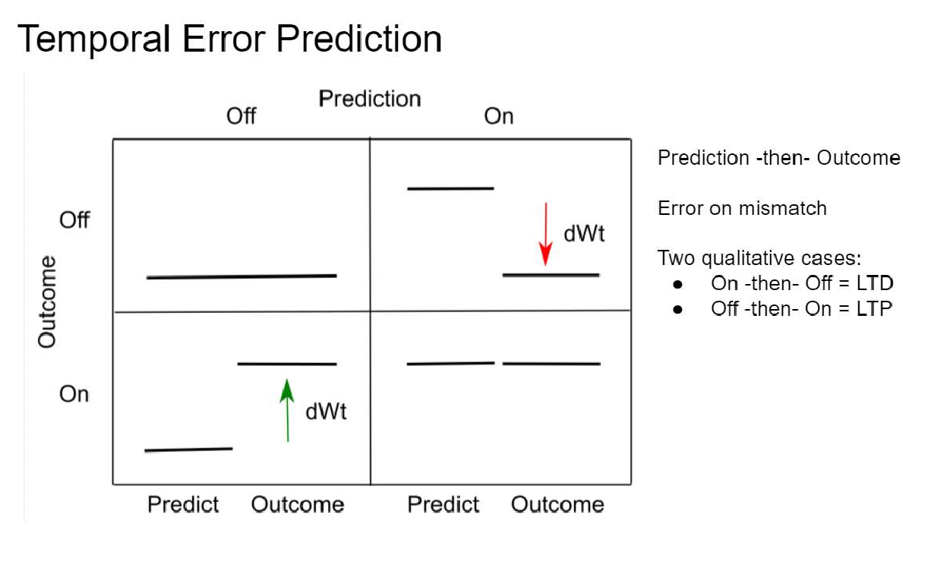
Testing Prediction (Jinyoung Jang, Cliff Moran, Karen Zito, in progress)

Slide 26
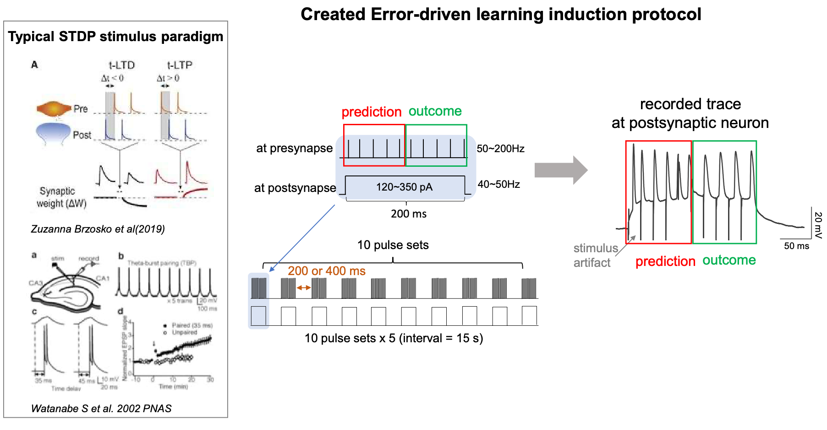
Stimulus Protocol

Slide 27
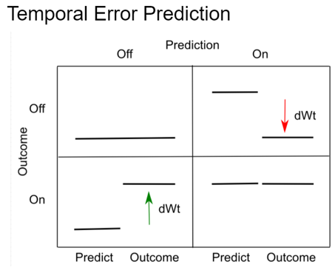
Protocols
Flat
25/25 Hz
50/50 Hz
100/100 Hz
25,50,100 Hz
200 ms
at presynapse
at postsynapse
120~550 pA
200 ms
Increase
25/50 Hz
50/100 Hz
Decrease
50/25 Hz
100/50 Hz
25,50 Hz
100 ms
50,100 Hz
100 ms
50,100 Hz
100 ms
25,50 Hz
100 ms
at presynapse
at presynapse
at postsynapse
120~550 pA
at postsynapse
120~550 pA
200 ms
200 ms

Slide 28
Results: 25-50Hz
25Hz→25Hz (n=7)
25Hz→50Hz (n=6)
50Hz→25Hz (n=8)
25Hz→25Hz (n=7)
25Hz→50Hz (n=6)
50Hz→25Hz (n=8)
-5~0 min
baseline
0~5 min
15~20 min
30~35 min

Slide 29
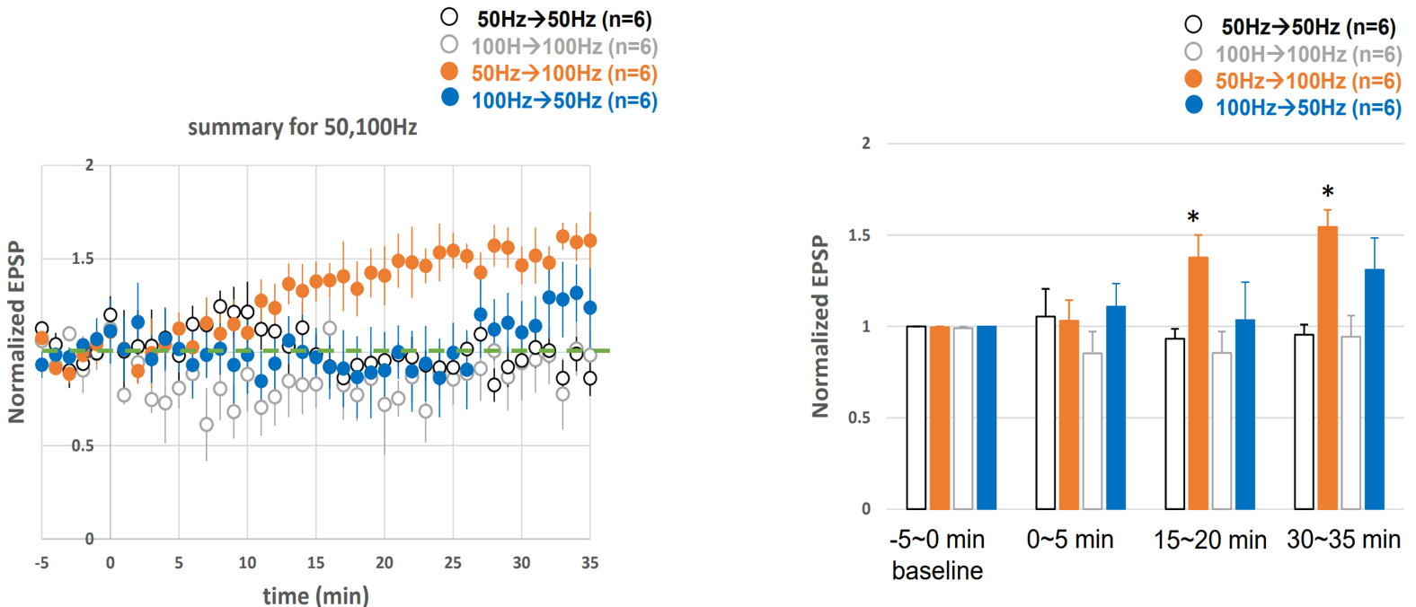
Results: 50-100Hz
5
5

Slide 30
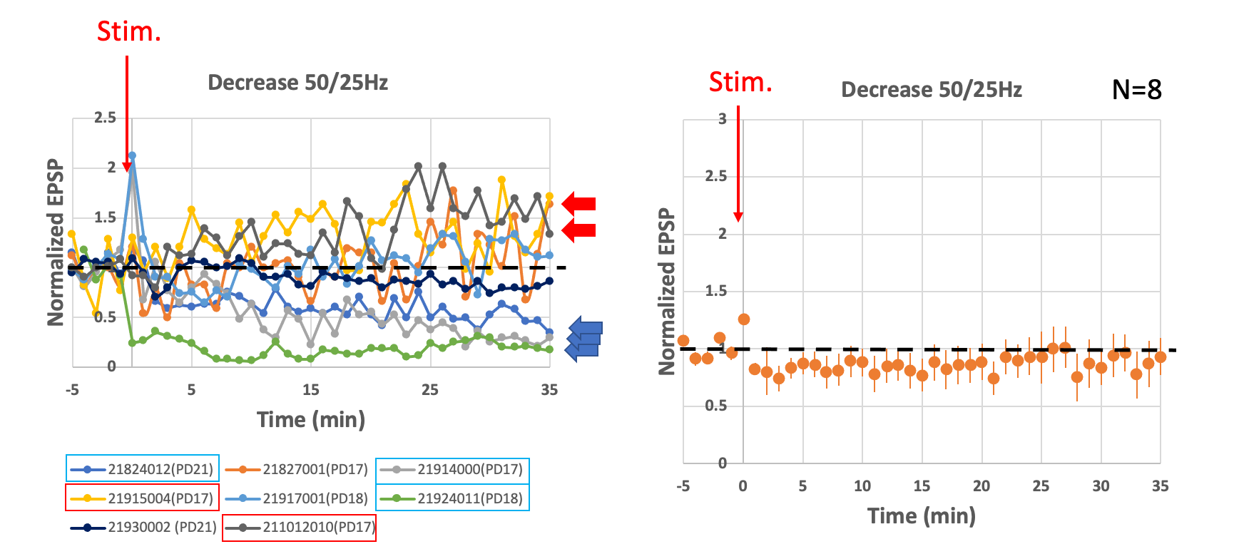
LTD for “Error” case: sometimes..

Slide 31
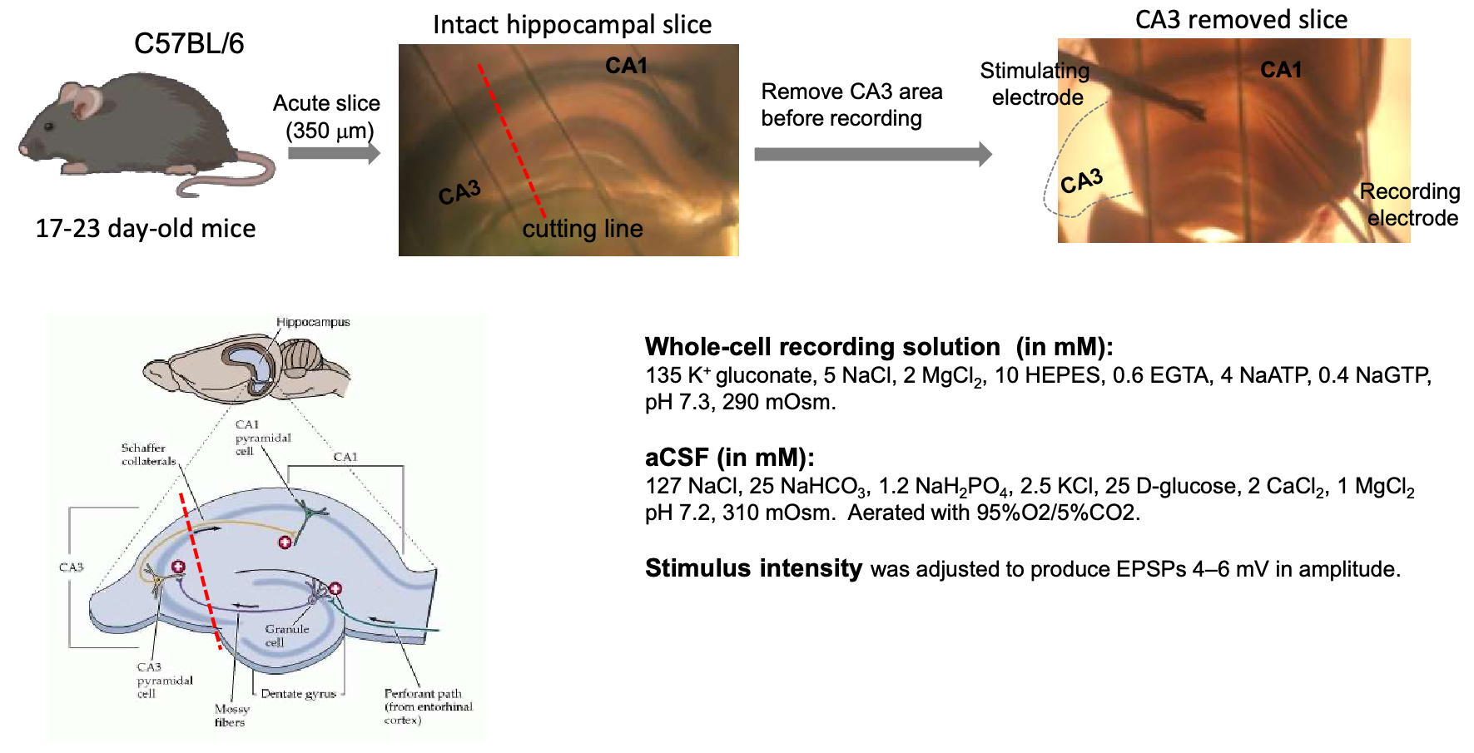
Method Details

Slide 32
Functionally: does it work?
Can merely predicting low-level sensory inputs produce higher-level abstract representations?
If not, maybe we still need that hand??

Slide 33
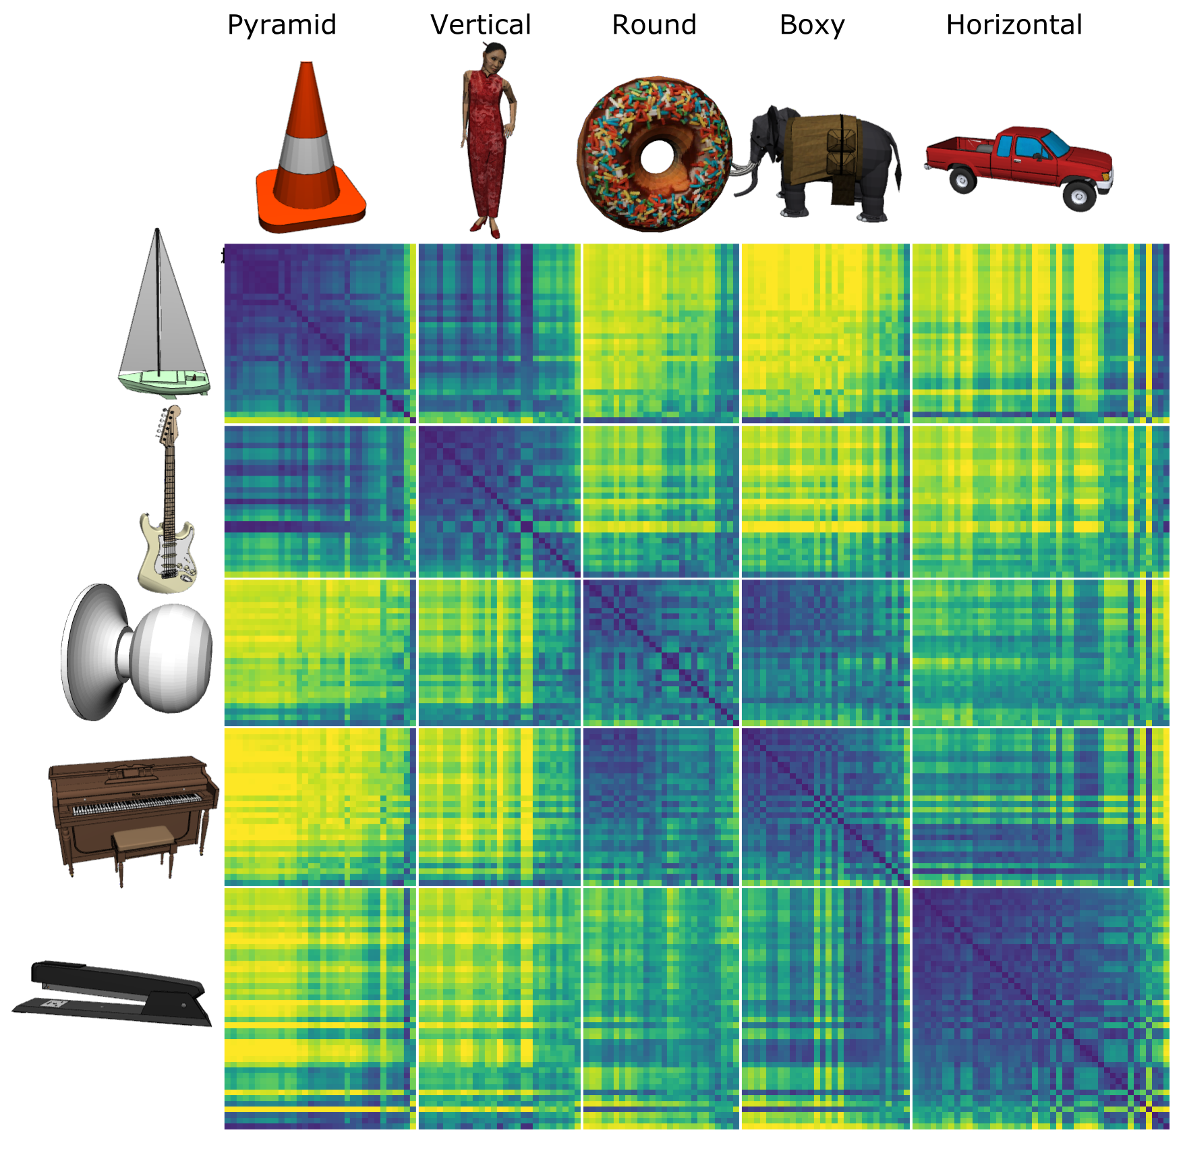
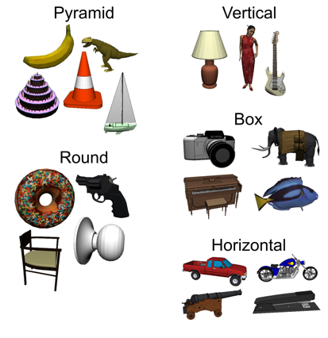
Model discovered
Shape categories!

Slide 34
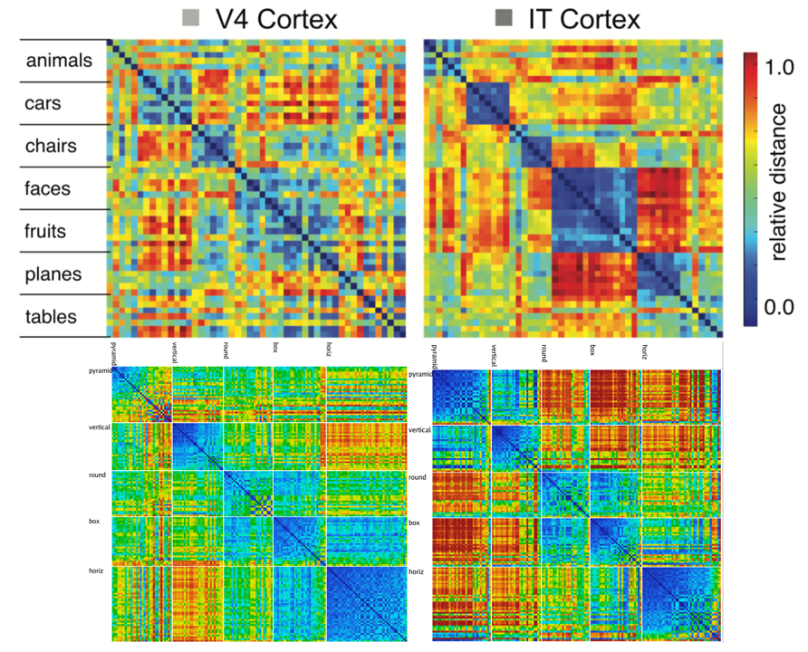
Model vs. Monkeys: Categories Emerge in Higher Layers

Slide 35
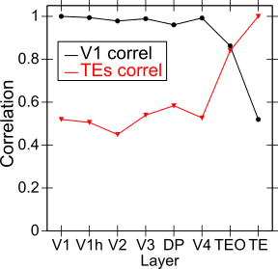
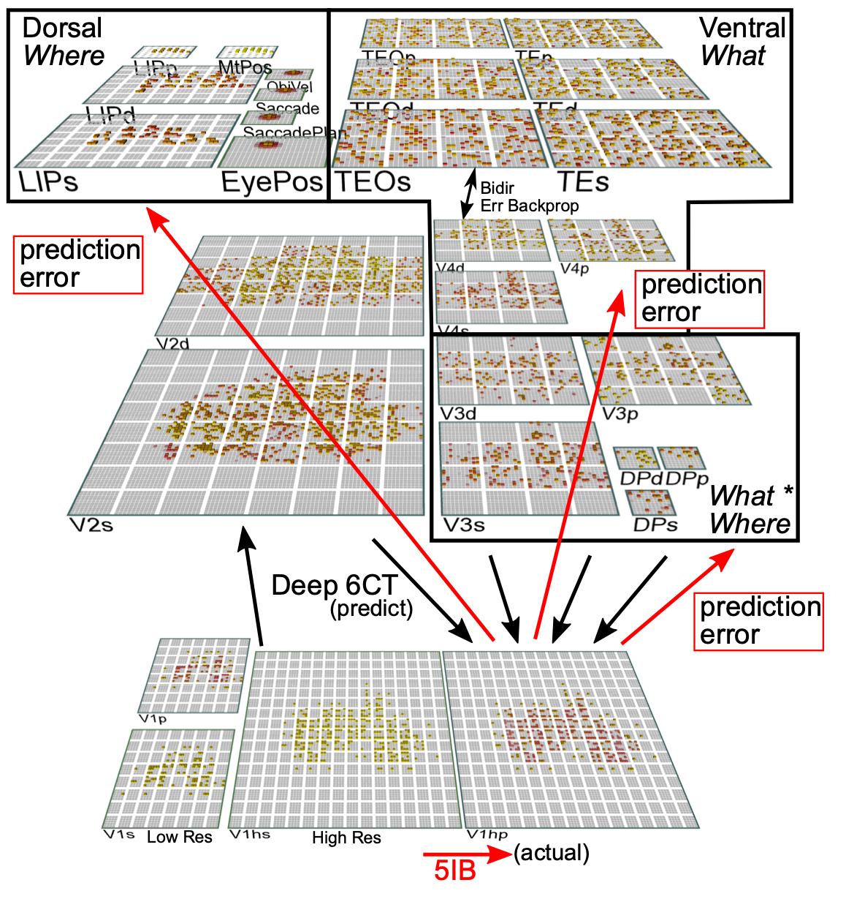
Categories not in V1; Emerge in IT Obj Rec Pathway

Slide 36
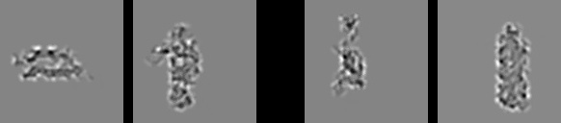
Model vs. Humans
Which pair is more similar in terms of overall shape?

Slide 37

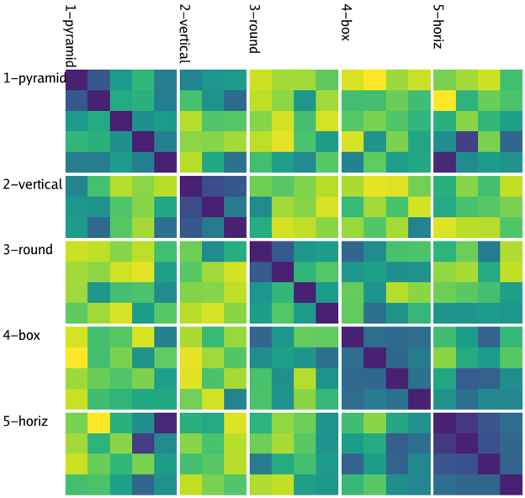
Model
People

Slide 38
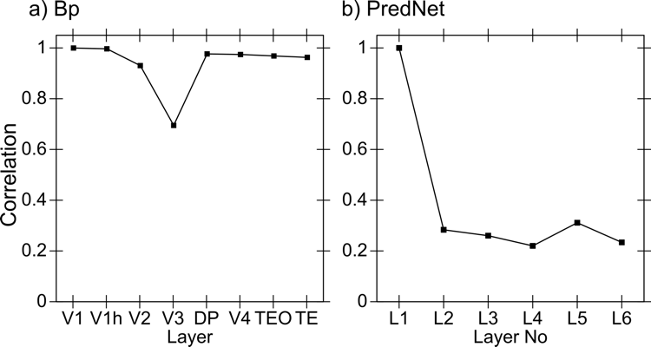
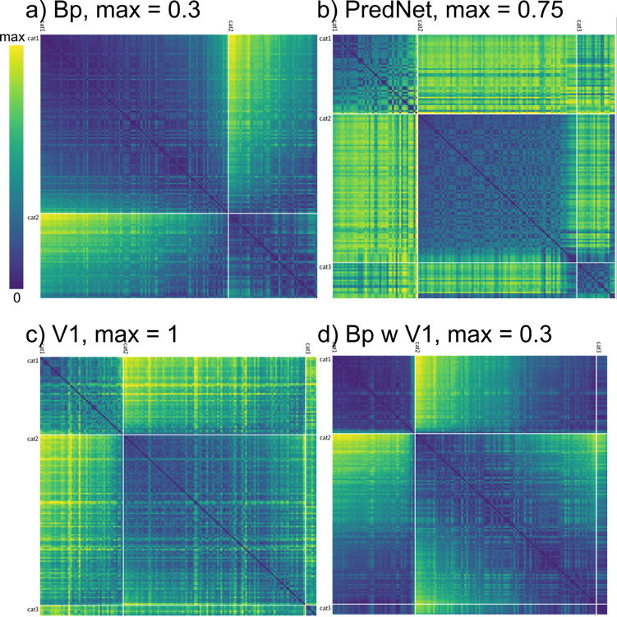
Backprop Comparison Models
No progressive formation of abstract categories -- low dimensional, V1-like representations even in highest layers
Diffs: Bidirectional connectivity, inhibitory competition, small amounts of Hebbian learning..

Slide 39
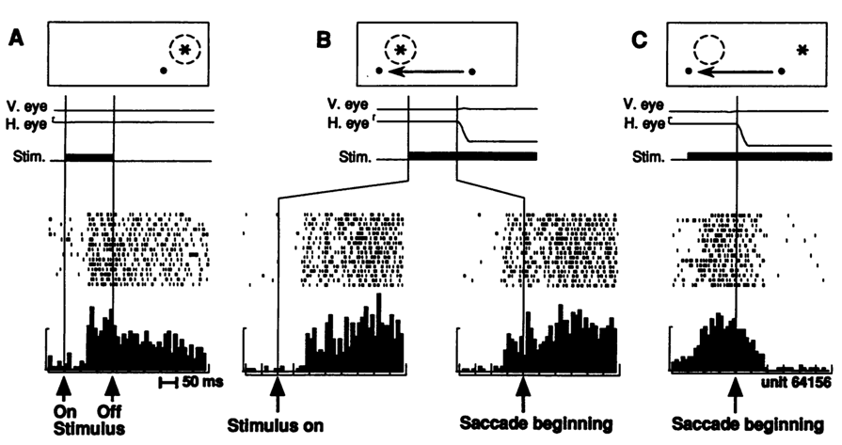
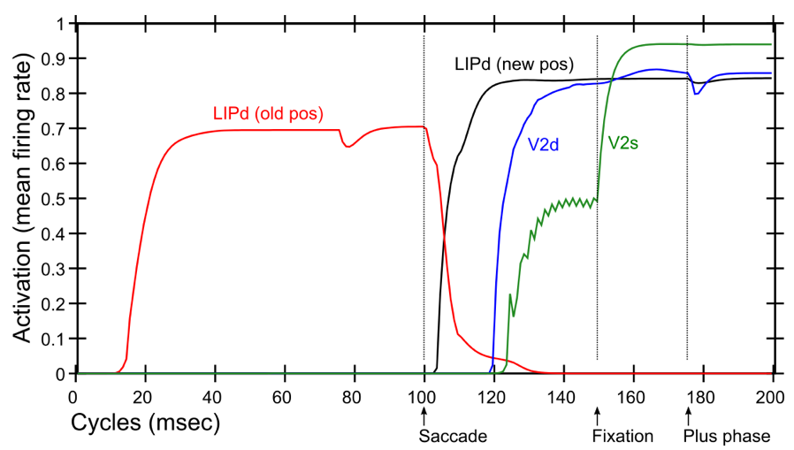
Predictive Remapping
Duhamel et al. (1992):
LIP neurons anticipate effect of saccade, start firing for new location before fixation lands (even before saccade)
Model:
LIPd remaps first at high, abstract level, drives top-down remapping in lower areas – consistent with Cavanagh et al. (2010)

Slide 40
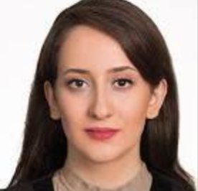
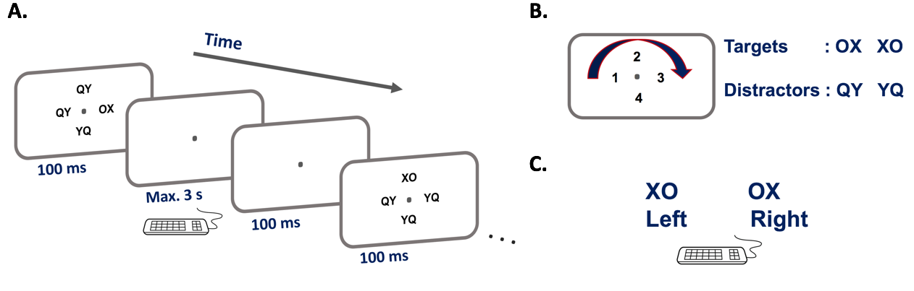
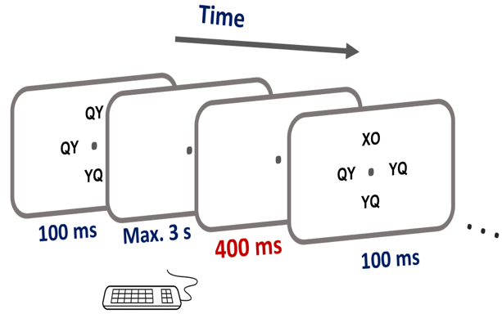
Experimental Test
Maryam Zolfaghar
Seq 1: 42132431
Seq 2: 13423124
Progression of early pre-stimulus activity pattern similar to post-stimulus

Slide 41

Speech Perception
John Rohrlich applying model to statistical learning in speech, using full auditory input.
Starting with Graf-Estes & Lew-Williams 2015 stimuli based on Saffran et al paradigm.
Shows reliable effects for reliable vs. unreliable sequences.

Slide 42
“What works”
AND
Neuroscience
Deep predictive learning:
- Works
- Fits with lots of biology
- Extends to motor, cross-modal predictions

Slide 43
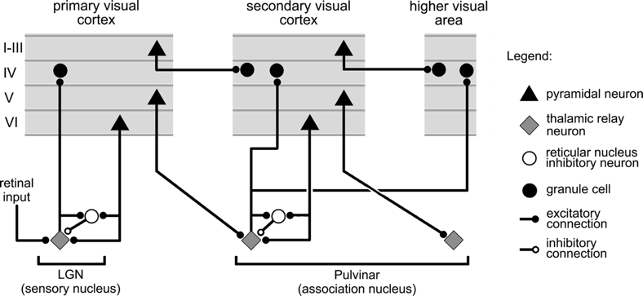
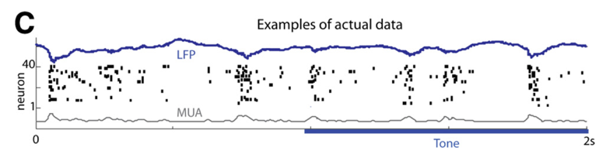
Key Biological Data
Strong, synchronized, low-frequency modulation of cortex (at the alpha frequency).
Specificity of alpha modulation to deep layers & thalamus, not superficial layers.
Nature of deep-layer connectivity to pulvinar: numerous, weaker, plastic pathway (for generating a prediction) and sparse, strong, fixed pathway (for ground truth target).
Synchronization of this strong pathway input with the alpha cycle.
Broad connectivity of pulvinar with different visual pathways (afferent and efferent).
Lack of direct bottom-up superficial projections into the deep layers (would short-circuit prediction), but presence of these projections top-down (beneficial).
Bidirectional (top-down and bottom-up) connectivity between superficial layers.
Early development of the Where (MT, LIP) pathway.
Organization into three separable (yet highly interconnected) visual pathways, particularly a third putative What*Where integration pathway.
(Buffalo et al., 2011; van Kerkoerle et al., 2014; Shipp, 2003; VanRullen & Koch, 2003; Luczak et al., 2013..)

Slide 44
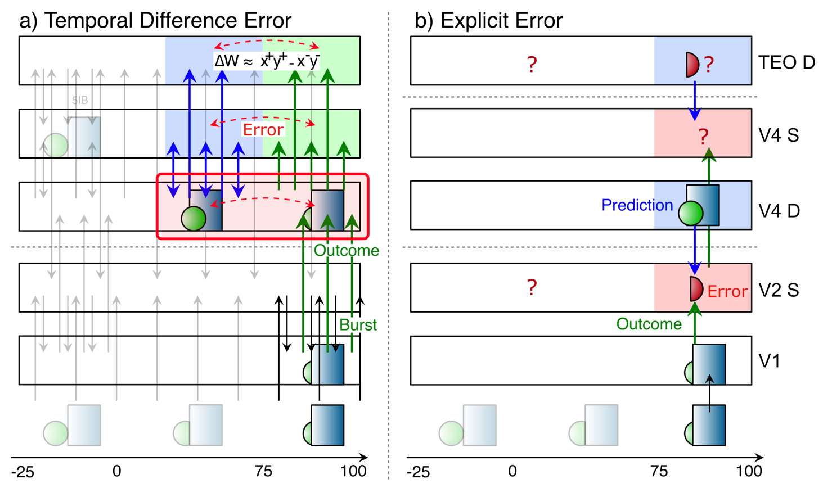
Key Diffs From Friston / Bayes

Slide 45
Conclusions
Peculiar features of connectivity between cortex and thalamus support form of predictive learning (many diffs from Friston etc).
Computational model shows that predictive learning from raw visual “movies” self-organizes abstract categorical object representations (based on shape, not texture!)

Slide 46
Thanks To
CCN Lab
Andrew Carlson
Riley DeHaan
Tom Hazy
Seth Herd
Kai Krueger
April Luo
Jessica Mollick
Ananta Nair
John Rohrlich
Jake Russin
Maryam Zolfaghar
Funding
ONR – Hawkins & McKenna

Slide 47
“Standard” approach (Friston et al)
Explicit error-coding neurons subtracting top-down vs. bottom up
But: no evidence of such cells!

Slide 48
Hebbian is too Dumb!
Babies exhibit some serious active, theory-like learning abilities!
Not just passive soaking up of statistics..

Slide 49
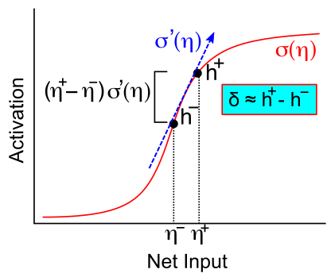
Activation Diffs Implicitly Compute Derivatives (GeneRec; O’Reilly, 1996)
Free to use arbitrarily complex activation functions!

Slide 50
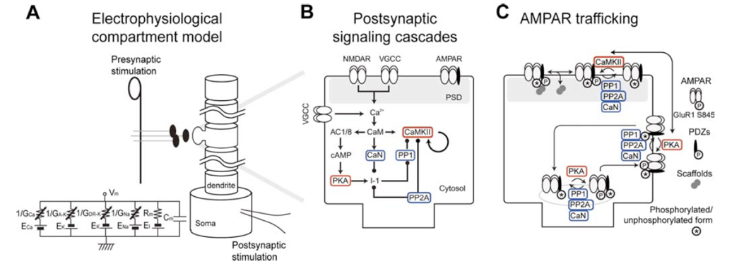
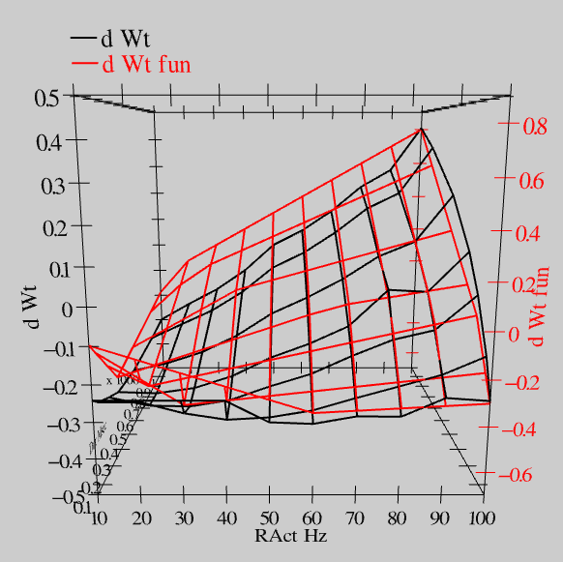
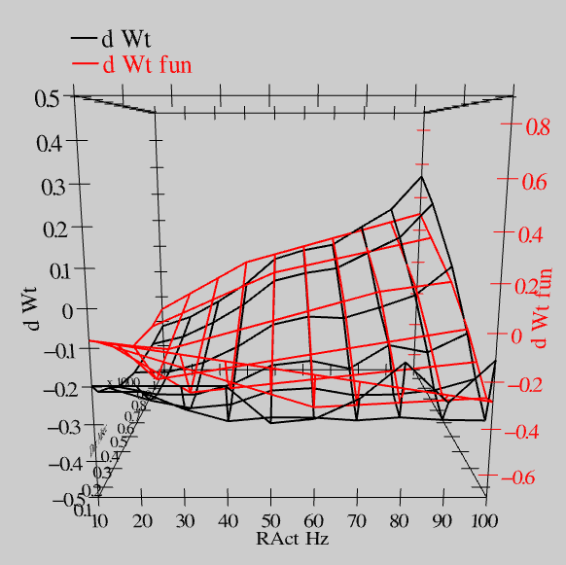
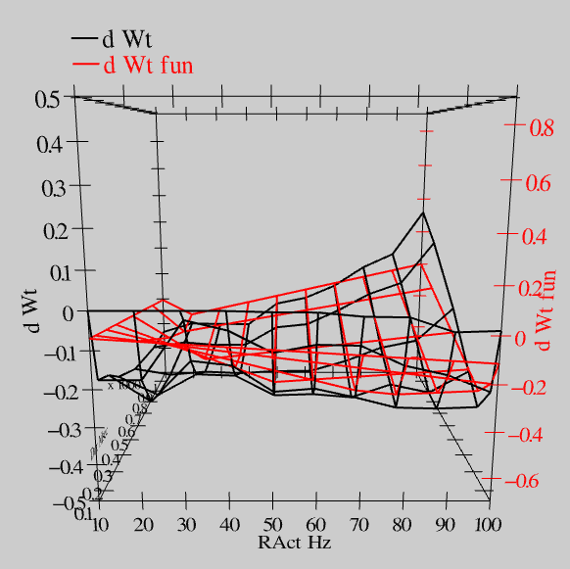
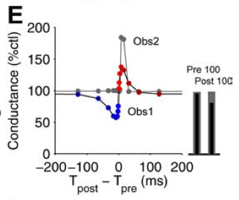
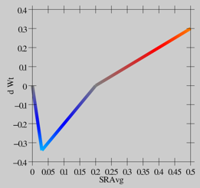
Synaptic Plasticity: XCAL Model (reduction of Urakubo et al, 2008 STDP model)
S = 100Hz
S = 50Hz
S = 20Hz
dW = f(send * recv) =
(spike rate * duration)
r=.894

Slide 51
Floating Threshold = Medium Term Synaptic Activity (Error-Driven)
dW = Outcome – Expectation = <xy>_{s} - <xy>_{m}

Slide 52
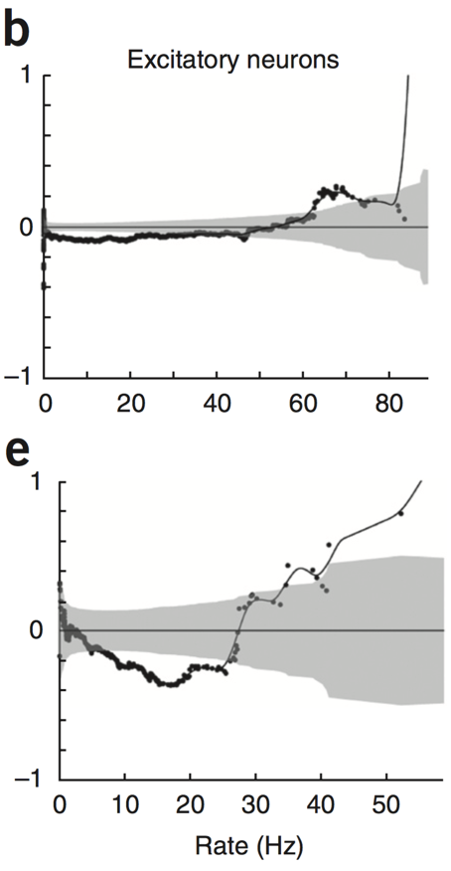
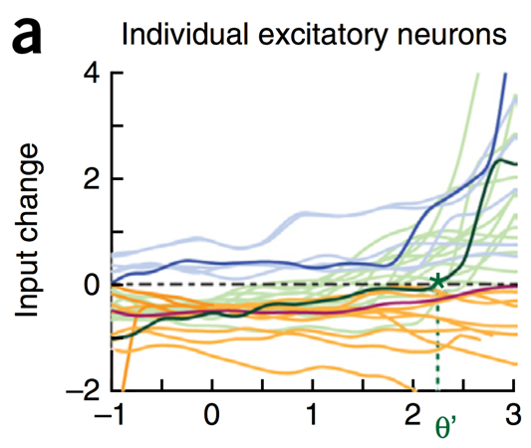
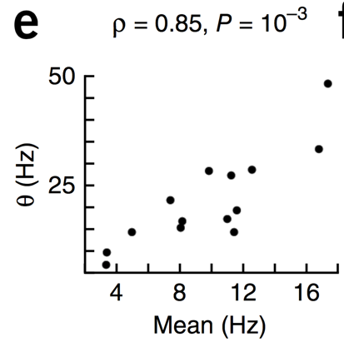
Evidence of Dynamic Thresholds (Lim, McKee, Woloszyn et al., 2015)
b = passive viewing
e = active task
Threshold changes dynamically on a rapid time scale, as a function of short-term activity level!

Slide 53

Deep Attentional Dynamics (Reynolds & Heeger, 2009; Grossberg, 1999)

